Slide 1


Masters in Global Public Health
Policy, Power, & Leadership in Global Public Health
2J7V0019
Assessment Briefing
Dr Nigel Cox

Slide 2
Agenda
PART ONE - Principles
Unit learning outcomes
Basic requirements for the assessment
Referencing requirements
Academic standards reminder
PART TWO – Guidelines, examples and tips
Overall structure at a glance
Front sections – what to include
Main body – types of case study, critical discussion
End sections – references, appendices

Slide 3

PART 1
Unit learning outcomes
Make sure you thread these throughout your essay
Here are the module learning outcomes. These are general themes and concepts. In your essay you will show that you understand them and can apply them to public health practice.
Describe and critically evaluate the theoretical and conceptual foundations that underpin global public health research, policy, governance, and practice
Investigate and critically analyse a selection of local, national, and global health systems and related policies that influence public health outcomes
Compare and critically analyse a range of national approaches to public health provision taking into consideration socioeconomic and cultural contexts
Explore the future of global public health leadership, its stakeholders, and their relationship to political, technological, moral, and environmental issues

Slide 4




What’s required for the unit assessment
Key technical points
Word count
You are required to produce an original desk-based case study about a public health issue relating to a specific context, population, or community (student choice of topic)
How long, and what is the pass mark?
Your case study will be an essay of 3000 words (+/-10%)
The pass grade is 50% and is graded at Level 7
The essay contributes to 100% of your grade for this unit
What format is required?
You upload this to Moodle/Turnitin in Microsoft Word format
Your essay must be written in the English language
Use font of size 12, 1.5 or double-spaced, pages numbered
Check Moodle for your submission date and the date when you’ll receive your grade

Slide 5


Other points to ensure
Slide 1 of 2
Excellent referencing
Using tables, figures and diagrams
No primary data collection
You must ensure that the submitted work is your own, original work, and that any sources of evidence and information that you include are referenced appropriately, see:
Tables, figures, and the reference list are not counted in the word allowance and may be used freely.
Be diligent, and take pride in your work – focus on making the essay your own original, professional writing
Avoid plagiarism, and always reference tables, figures, etc. that are not your own, original work (see video link later)
Only your own desk-based research study is required for this assessment. You must not conduct primary research (empirical data collection) for this assessment

Slide 6
Other points to ensure
Slide 2 of 2
Excellent referencing
As a public health professional, you should strive for excellence in your use of references/resources
Using the references provided within the reference list and upon the lecture slides is acceptable ... however,...
For a higher grade you must also show evidence of your own wider independent reading, such as:
Theories that relate to your topic (classic, or new)
Recent research findings (primary studies or SRs)
Emerging policies or legislation (national or international)
NGO literature (charity reports, service user evidence)
Grey literature (informal published resources)

Slide 7

FRONT SECTIONS (not included in the word allowance)
Title page (essential)
Executive summary (essential, <150 words)
Contents page (essential)
Acronym page (optional)
MAIN BODY (3000 words allowance +/-10%)
Your case study (examples on following slides)
Neatly structured discussion (paragraphs, sections)
Thoroughly resourced and referenced
REFERENCES (not included in the word allowance)
Presented in the required Harvard format
Approximately 35-45 in number (no upper limit)
APPENDICES (not included in the word allowance)
Optional. Should not contain core discussion.
FIGURES, TABLES, etc. (not included in the word allowance)
Can be used freely throughout. Must be referenced.
PART 2
ESSAY STRUCTURE
AT A GLANCE
Overall structure of your case study

Slide 8

FRONT sections of your essay
(not included in the word allowance)
A professional-style report will have helpful but concise sections before the main body of writing
We recommend:
Title page (essential, not included in the word allowance)
A good report title usually comprises a topic, followed by a colon, and then another clause providing context.
e.g. “Dengue cases in Latin America: the role of community-led education in public health management”
Executive summary – this is essential. Think of this like an abstract for a public audience. No more than 150 words. This is not included in the word allowance.
Contents page – essential too. Did you know Microsoft Word can create this automatically for you? Also not included in the word allowance.
Acronym page optional, some people might find this useful. Again, not included in the word allowance.

Slide 9

The MAIN BODY of your essay
(3000 words)
Your essay comprises a written case study of 3000 words.
There’s no definitive approach to writing a case study – on the following slides we set out some general approaches to take
The structure of the main body will vary according to your choice of topic and writing style
Your case study will require you to synthesise (bring together) a range of ideas in a clear and organised way
This can be a thought-provoking exercise, and so we recommended that you discuss your ideas in class
Examples follow on the next slide ...

Slide 10

Case study types
Slide 1 of 2
There isn’t a definitive form of case study
Here are some general types and some fictional examples
Exploratory Case Study
This type of case study aims to explore the contexts and topic of interest with the goal of identifying new or emerging issues.
e.g. “Social media and body image amongst Japanese youth: what are the future implications for public health practice?”
Explanatory Case Study
This type of case study aims to explore ‘what, why and how’ specific issues or challenges have arisen.
e.g. “British children’s school attendance following the Covid-19 pandemic: why are some students reluctant to return?”
Intrinsic Case Study
This type of case study aims to explore a specific issue or topic that is unique to a narrowly defined context, population
e.g. “Suicide and self-harming behaviours in Australian mining workers: an invisible public health crisis?”

Slide 11
Case study types
Slide 2 of 2
Instrumental Case Study
This type of case study is focused on a single case but uses this to explore wider theories, concepts, or principles, and explores their application or transferability to different contexts.
e.g. “Peer support networks for alcohol recovery in Oslo, Norway: is this approach transferable to other contexts?”
Comparative Case Study
This type of case study selects two or more contexts, populations or communities and compares/contrasts them, exploring commonalities and policy or practice gaps
e.g. “Comparing rich and poor: the impact of a national diabetes prevention scheme upon two communities in Abuja, Nigeria”

Slide 12
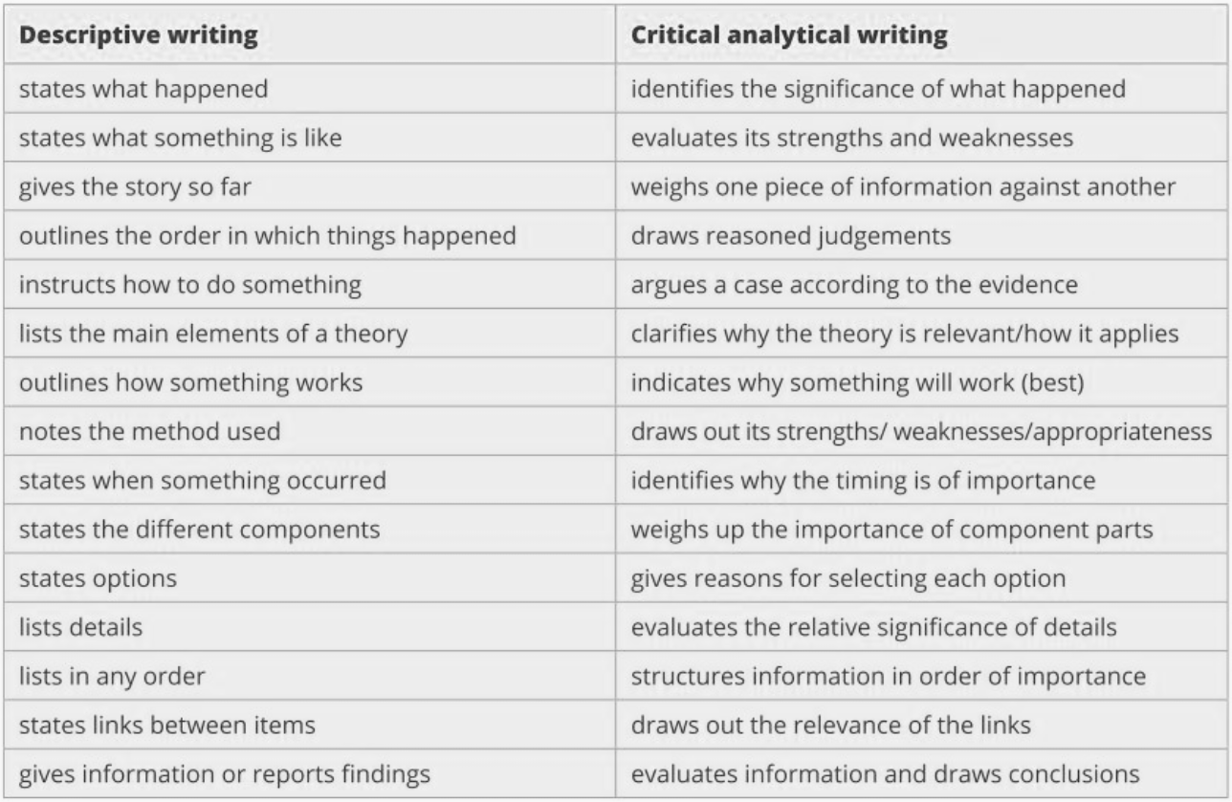

Writing at Level 7 and for a professional audience
Descriptive writing ‘sets up’ your discussion. You will need to include some of this, but it must not dominate your writing.
Critical analytical writing ‘delivers’ the high-flying professional-level debate and application to the real-world
From: Cottrell, S. (2019). The study skills handbook

Slide 13

Nobody can teach you how to synthesise your ideas, but there are some key ingredients to consider.
Synthesis can only occur once you’ve engaged with the following processes and considerations:
What is the problem I’m trying to solve here?
Have I incorporated theory, evidence and policies?
Have I read further about society, economics, culture?
Have I factored in politics, ideology, religion, technology?
Have I discussed my ideas with colleagues and peers?
Have I given myself time think deeply about my ideas?
Making sure you do all these things will put you in the best position to synthesise – bring together – your ideas.
Synthesising your ideas
Synthesis involves choosing and combining ideas and evidence to create something new or a solution to a problem

